Slide 1
Historical Perspective of Mathematics
By- Dr. Meena Sharma

Slide 2
Historical Evolution of Metrics
Details

Slide 6
FATHOM

Slide 9
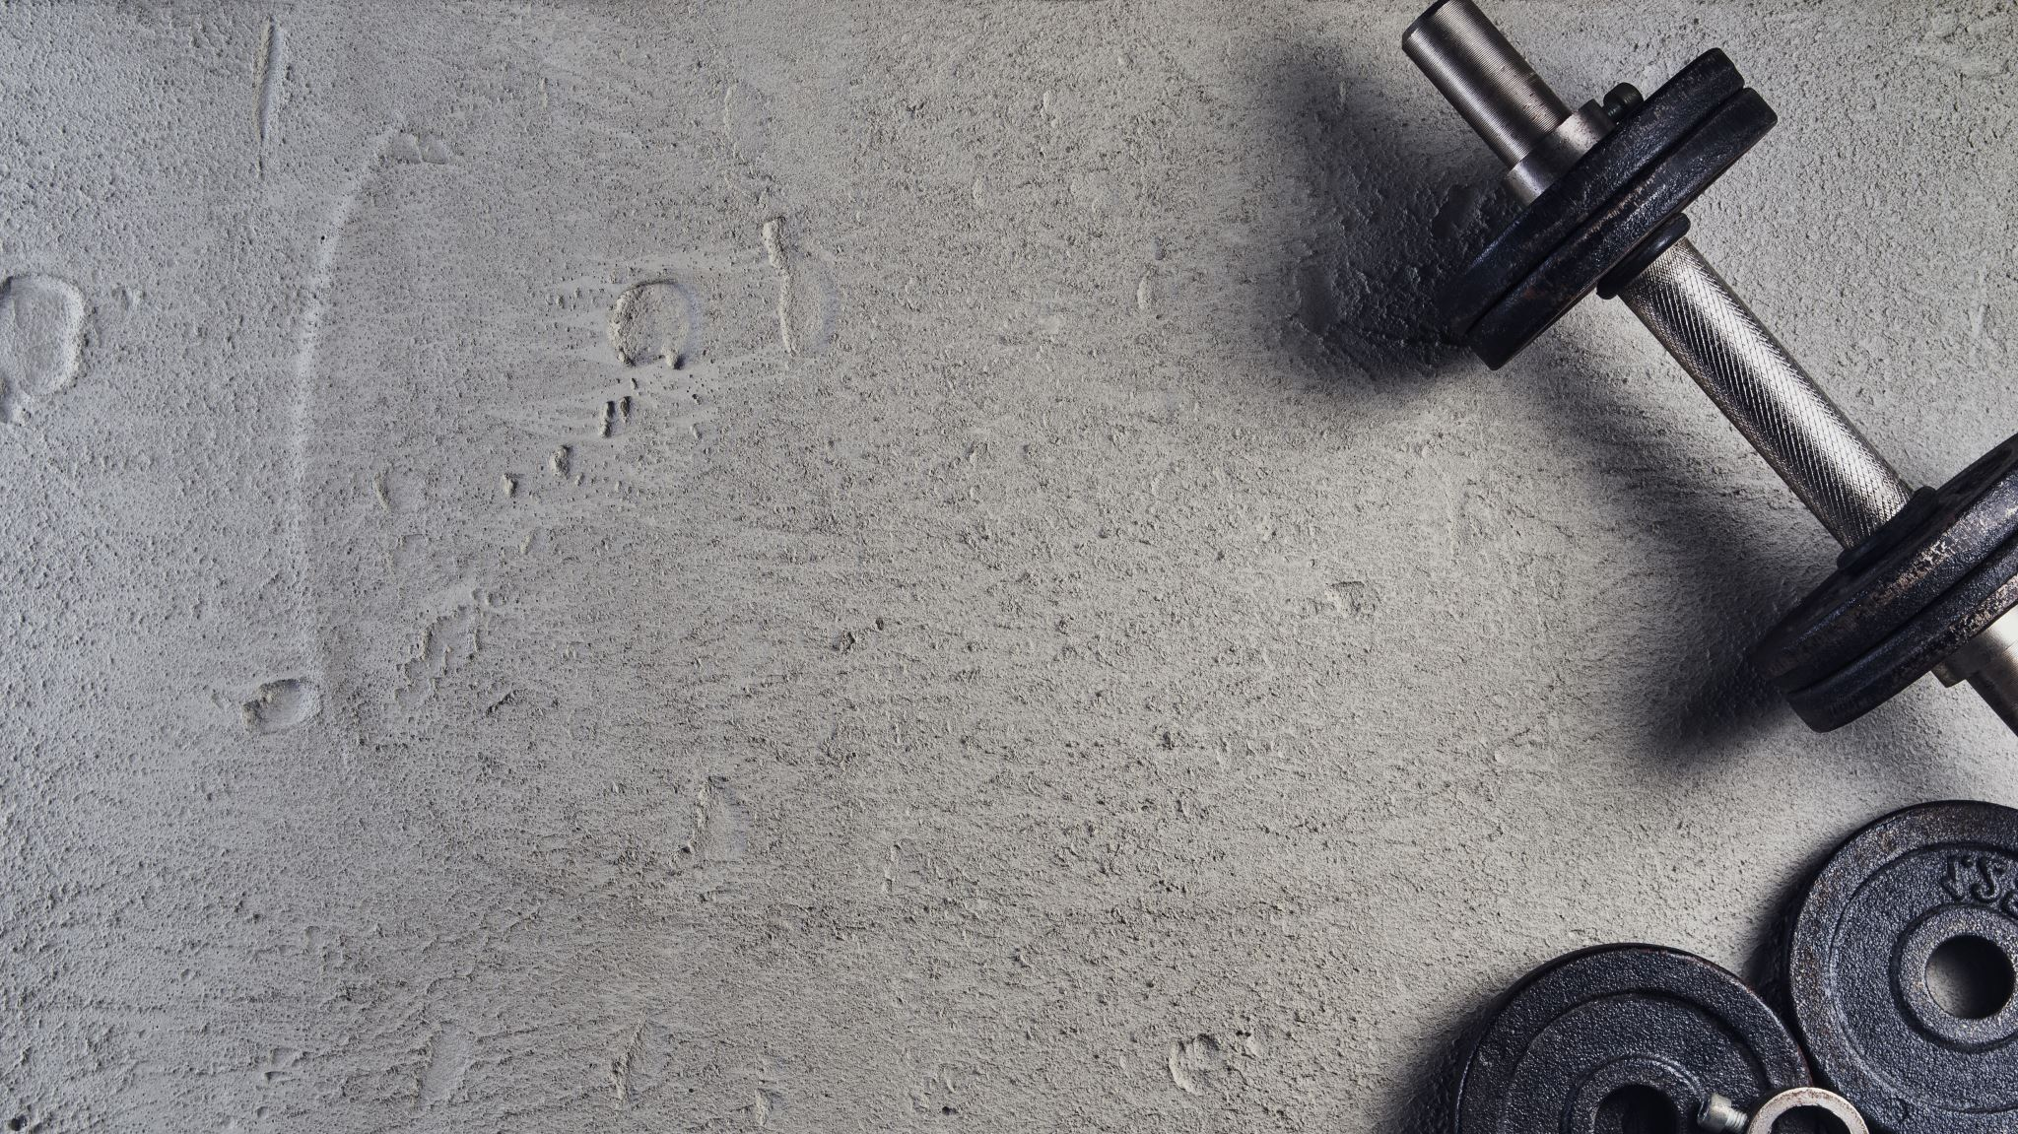
Historical Evolution of Weights

